Slide 1



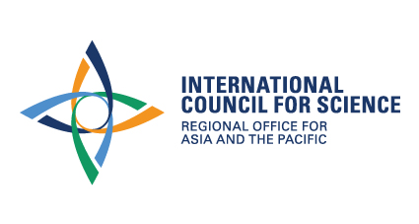

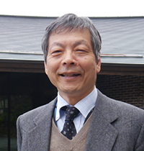
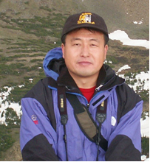
FUTURE EARTH MONGOLIAN COMMITTEE
INVITED SPEAKER PROGRAM
10:00 June 8, 2018 Library, room #502, NUM
Future Earth: Research for Global Sustainability
Prof. YASUNORI Tetsuzo,
Director General, Research Institute for Humanity and Nature (RIHN), Japan
Bibliography: Prof. Tetsuzo YASUNARI is director general of Research Institute for Humanity and Nature (RIHN) in Kyoto, Japan. His main fields of study are climate dynamics and global environmental change including human impacts on the earth climate system. He is Chairman of the Future Earth National Committee under Science Council of Japan, and member of the Advisory Committee for Future Earth. He is a review editor of IPCC-AR6 (Working Group I), and also served as a review editor of IPCC-AR5, a contributor for IPCC-FAR and SAR.
Digital Belt & Road - Climate change and disaster risks
Prof. JIA Gensuo,
Deputy Director, Key Lab of Regional Climate-Environment for East Asia, Institute of Atmospheric Physics, CAS, China
Bibliography: Prof. JIA Gensuo has broad research interests in terrestrial ecology and atmospheric sciences, including multi-scale remote sensing of land surface processes, ecosystem-climate interactions, climate extremes and natural disasters, and climate change impacts and adaptation. He published over 90 peer reviewed papers in science journals including Science, Global Change Biology, BAMS, Remote Sensing of Environment, Geophysical Research Letters, and Climatic Change in recent years.

